Slide 1


Deploying Scalable ML for Data Science
Anthony Mipawa

Slide 2

Introduction
ML Models building process
Deploying codes to servers.
Ensuring continuous availability.
Programmatic access(APIs)
Access controls
Scalability
Requirements for ensuring that Applications are Scalable.
Three Layers of Scalable ML stack
Orchestration tools for managing clusters of servers
Containers monitoring tools
All is to ensure best practice of deployment of ML models.

Slide 3
My assumptions to audience
Familiarity with Machine Learning.
Comfortable reading programming code.
Understand operating system principles such as processes , CPU utilization , disk utilization and I/O etc

Slide 4
The Need to Scale ML Models
1.0 Building & Running ML for Data Scientist
Uses of Machine Learning
Pricing
Fraud detection
Document Classification
Data Scientist we have to ask:
What problem we’re trying to solve?
What are business requirements need to consider?

Slide 5
The Need to Scale ML Models
1.1 Building & Running ML for Data Scientist
Defining the Problem
Be Precise | Too Vague
Describe the problem that can be modeled | General description of what we want
State quantifiable problem such as Reducing number of customers leaving for a competitor | A broad statement such as Improve customer satisfaction

Slide 6
The Need to Scale ML Models
1.2 Building & Running ML for Data Scientist
Building Models
Regression | Classification
Make numeric value predictions | Make choices among categorical variables
Estimated values of a stock Best price to charge for a hotel room Number of new customers new sales pricing can attract | Legitimate credit card charge vs Fraudulent charge Identifying an object in an image Customer likely to respond to an advertisement

Slide 7
The Need to Scale ML Models
1.3 Building & Running ML for Data Scientist
Data collection
Time consuming
What is the data describing?
Are there quality control problems?
Is there missing data?
Inconsistent conversions

Slide 8
The Need to Scale ML Models
1.4 Building & Running ML for Data Scientist
Best practice
Data distribution.
Explore data - understand kind of data you’re working with.
Iterative Model building

Slide 9
The Need to Scale ML Models
2.0 Building & Deploying ML Models for Production use:
What to consider
Deploying codes to servers.
Ensuring continuous availability.
Programmatic access(APIs)
Access controls
Scalability
Persisting Models:
Language specific
Predictive Model Markup languages like html , xml

Slide 10
The Need to Scale ML Models
2.1 Building & Deploying ML Models for Production use:
Models are Software
Version control.
Testing.
Security after deployment

Slide 11
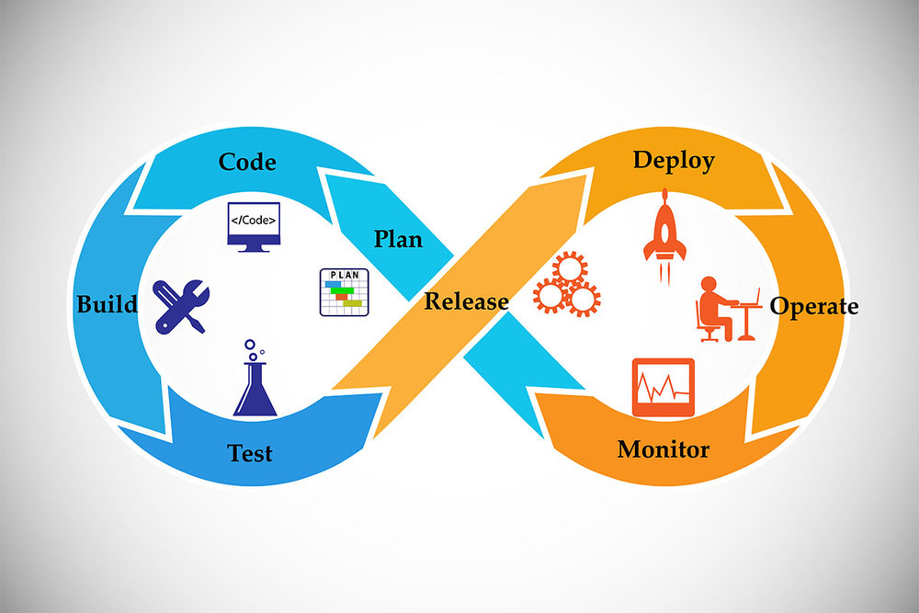
The Need to Scale ML Models
2.2 Building & Deploying ML Models for Production use:
Update Models

Slide 12
The Need to Scale ML Models
2.3 Building & Deploying ML Models for Production use:
Canary Deploys
canary deploy
current production
Development & Test

Slide 13
The Need to Scale ML Models
2.4 Building & Deploying ML Models for Production use:
Canary Deploys
canary deploy
current production
Development & Test

Slide 14
The Need to Scale ML Models
2.5 Building & Deploying ML Models for Production use:
Blue/Green Deploys
current production
current production
Development & Test

Slide 15
The Need to Scale ML Models
3.0 Definition of Scaling ML for Production
Meaning of Scalable ML:
Keep up depending on the demand variations.
Produce responses in a timely manner
How to know if your system is scalable?
Scalable System can use additional resources when load increases
Scalable System can release resources when are not in use.
Load balancer
Autoscaling Constraints
Building a Scalable systems is a technical challenge

Slide 16
The Need to Scale ML Models
3.1 Definition of Scaling ML for Production
Redundancy Compensates for Failure:
Such as Servers crush, disk failure,Rack loses power etc. non-preventable failure
Common way of dealing with these frequent failures:-
To use Redundant components
Cluster of servers
If server from one cluster fails by auto-scaling another server will be added to ensure availability of service.

Slide 17
The Need to Scale ML Models
4.0 Overview of the tools and Techniques for Scalable ML
Microservices:
Deploy the model with an APIs.
Run the model and API in a container.
Manage the container using an orchestration service.
Deploying to Multiple servers:-
From source codes
Need libraries and Package
Watch for differences in operating systems

Slide 18
The Need to Scale ML Models
4.1 Overview of the tools and Techniques for Scalable ML
Containerization:
Solve Operating systems potential installations problems.
Example of most used containerization service is Docker
Orchestrations:
Platform for managing containers
Example of most used containerization service is Kubernetes
Management tasks by kubernetes:
Horizontal Scaling,Optimized placement of containers, Automated rollouts of new versions of code, Storage management , self healing.

Slide 19
The Need to Scale ML Models
4.2 Overview of the tools and Techniques for Scalable ML
Three Levels to Scalability :
Exposing the ML model through an APIs.
Putting the model and APIs in a container.
Managing the container with an orchestration platforms.

Slide 20
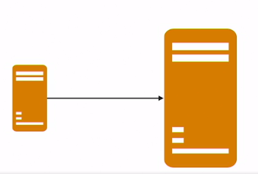
Design Patterns for Scalable ML Applications
1.0 Horizontal vs Vertical Scaling
Vertical Scaling:
Replace a single server with larger servers(replace servers).
Increase number of CPUs
More Memory
More storage

Slide 21
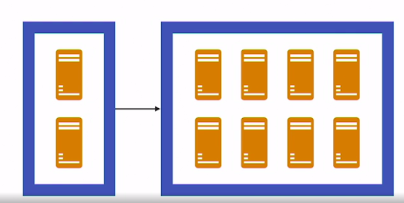
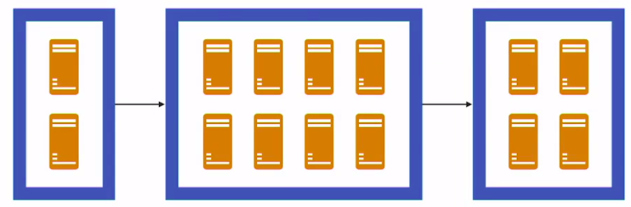
Design Patterns for Scalable ML Applications
1.1 Horizontal vs Vertical Scaling
Horizontal Scaling:
Adding servers to a cluster or distributed servers.
Removing servers to a cluster 0r distributed servers.
Running same software.

Slide 22
Design Patterns for Scalable ML Applications
1.2 Horizontal vs Vertical Scaling
Peak Demand:
With vertical scaling,need to plan ahead for peak demand.
With horizontal scaling, adapt to peak demand
Cloud services are designed to accommodate varying demand.
AWS
Azure
Google Compute Cloud

Slide 23
Design Patterns for Scalable ML Applications
2.0 Running Models as Services
What is services mean?
Software abstraction for describing executing programs that share common characteristics.
Accessible over network
Invoked using standard protocols
Perform a single function
Can be deployed in parallel

Slide 24
Design Patterns for Scalable ML Applications
2.1 Running Models as Services
How to distinguish services?
Way of data exchange
Example restful services - often pass data in JSON structure
High-volume services sometimes use other protocols such as thrifts or protocol buffers

Slide 25
Design Patterns for Scalable ML Applications
3.0 APIs for ML Model services
APIs best practice:
Including term api in url
https://scalablemodels.com/api/classify
Including version due to variation of updates
https://scalablemodels.com/api/v01/classify
Call APIs with parameters
https://scalablemodels.com/api/v01/classify?sl=5.1&sw=3.5&pl=1.5&pw=0.3
Once you invoke: {“species”:”Iris setosa”}

Slide 26
Design Patterns for Scalable ML Applications
3.0 APIs for ML Model services
APIs best practice:
API key: unique string that identifies a user
https://scalablemodels.com/api/v01/classify?sl=5.1&sw=3.5&pl=1.5&pw=0.3
&key=A1765342aH48ed
Key may be useful in access control and services payment

Slide 27
Design Patterns for Scalable ML Applications
4.0 Load balancing & Clusters of servers
Load Balancer Features:
Distribute workload.
Detect unhealthy servers and stop sending requests.
Are configured for high availability
Able to meet demand
Load Balancing Methods:
Client-side balancing
Random choice
Round-robin
Least connections
Least Load

Slide 28
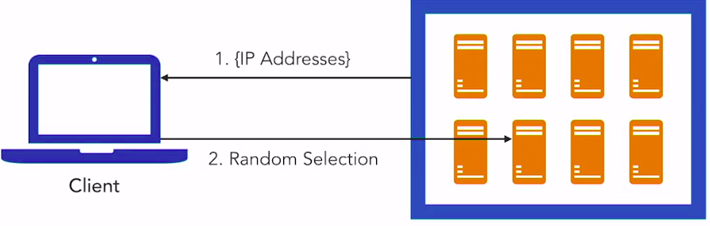
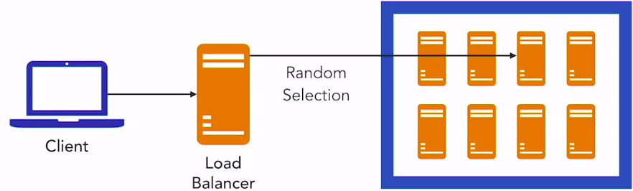
Design Patterns for Scalable ML Applications
4.1 Load balancing & Clusters of servers
Client-side balancing:
Random choice balancing:

Slide 29
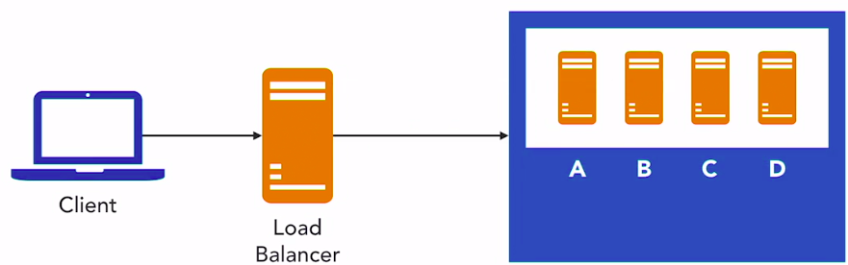
Design Patterns for Scalable ML Applications
4.2 Load balancing & Clusters of servers
Round-Robin Balancing:
Load Balancer Additional Features:
Application health check
HTTP compression
Firewall
Intrusion detection and prevention

Slide 30
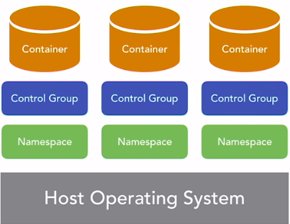
Design Patterns for Scalable ML Applications
4.3 Load balancing & Clusters of servers
Container images:
Base Operating System
Programming Languages
Machine Learning code
Packages and Libraries

Slide 31
Design Patterns for Scalable ML Applications
4.4 Load balancing & Clusters of servers
How to Create Container images?
Specify container contents
Execute build operation to create the image
Store the image in a repository
Download image to servers

Slide 32
Deploying ML Models as Services
1.0 Service encapsulate ML models
Documentation:
The HTTP URL
List of parameters and types
Request body if JSON structure is used
Swagger is the popular tool for automating and generating API documentation. For more info visit https://swagger.io

Slide 33
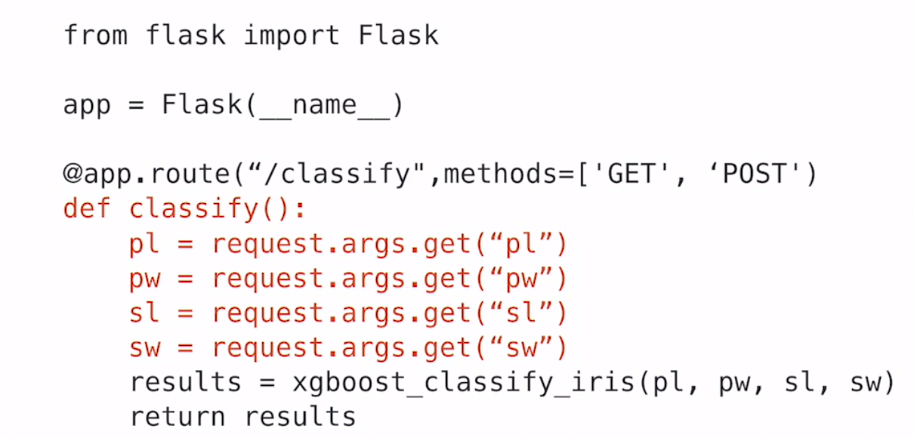
Deploying ML Models as Services
2.0 Using Flask to Create APIs
Example of python Classifier:

Slide 34
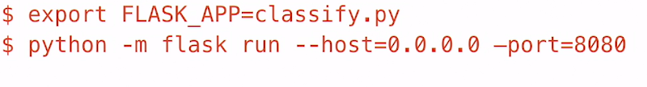
Deploying ML Models as Services
2.1 Using Flask to Create APIs
Running python program with Flask:
Calling python service with Flask from client:
Results:

Slide 35
Deploying ML Models as Services
3.0 Best Practices for API Design for ML Models
RESTful Best Practices:
Use a RESTful interface
Use the GET or POST commands.
Document your APIs
General APIs Best Practices:
Name the endpoints with informative names ,like classify
Use API tools, like Plumber and Flask
Include the term API in the path of you URLs
Include the version number in the API
Use API keys to control access of your services

Slide 36
Running ML Services in Containers
1.0 Why Containers?
Install and test once
Not each time we start a new server
Each deploy runs the same set of components
Minimal delay to servicing requests
Docker is the most widely used containerization platform.

Slide 37
Running ML Services in Containers
Docker Components
Docker engine
Docker client
Docker Registry
Getting a Docker Image:
Download from Registry
Build from Dockerfile

Slide 38
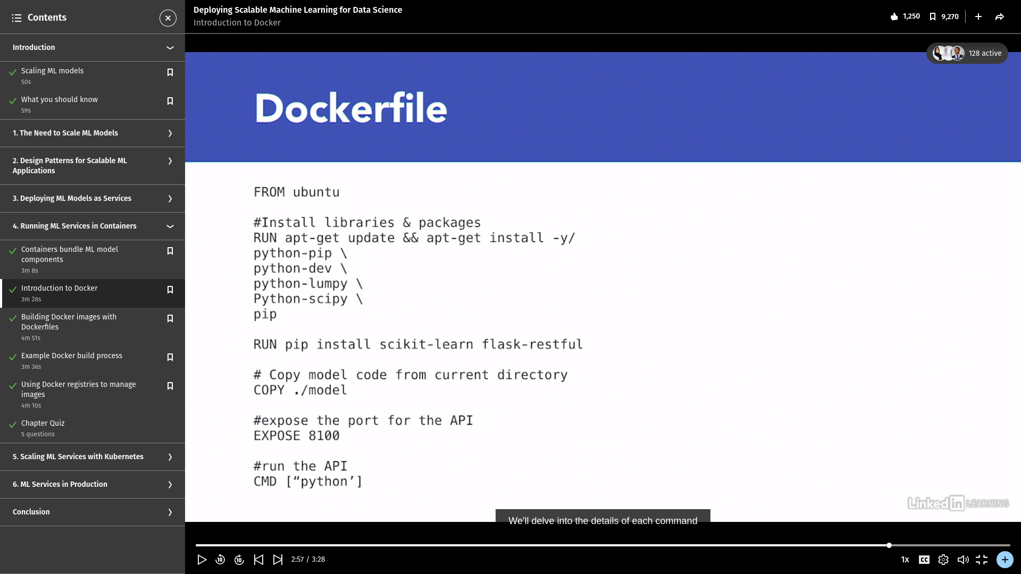
Running ML Services in Containers
Dockerfile

Slide 39
Scaling ML Models with Kubernetes
1.0 Management Tasks
Starting and Stopping Containers
Determining where to run containers
Checking the health of containers
Restarting and Replacing unhealthy containers

Slide 40
Scaling ML Models with Kubernetes
2.0 Orchestration Platforms
Kubernetes
Docker Swarm
Mesos and Marathon

Slide 41
Scaling ML Models with Kubernetes
3.0 Introduction to Kubernetes
Open source platform
Automating deployment
Scaling
Management of containerized applications

Slide 42
Scaling ML Models with Kubernetes
4.0 Creating a Kubernetes cluster
Usually a kubernetes cluster is run by an infrastructure team.
Kubernetes components
Minikube
A virtual Machine
Kubectl: a command line tool

Slide 43
Scaling ML Models with Kubernetes
5.0 Creating a Kubernetes cluster
Run created kubernetes cluster
Deploy containers in a Kubernetes cluster
Scaling up a Kubernetes cluster
Autoscaling a Kubernetes cluster

Slide 44
ML Services in Production
1.0 Monitoring service performance
Monitoring targets:
Baseline performance
Unusual events
Three Monitoring Domains
Services
Containers
Clusters

Slide 45
Conclusion
Best Practices for scaling ML
Horizontal Scaling
Deploy model with APIs
Use containers
Use orchestration tools
Monitor all levels of the stack

Slide 46


